Slide 1
PHD Finance Predict Alpha Signal
-Badreesh Shetty

Slide 2
What is Alpha Signal?
1. Alpha factors are designed to extract signals from data to predict asset returns for a given investment universe over the trading horizon. A factor takes on a single value for each asset when evaluated, but may combine one or several input variables.
2. Alpha factors emit entry and exit signals that lead to buy or sell orders, and order execution results in portfolio holdings. The risk profiles of individual positions interact to create a specific portfolio risk profile. Portfolio management involves the optimization of position weights to achieve the desired portfolio risk and return a profile that aligns with the overall investment objectives.

Slide 3
Why Alpha Signal?
1.To minimize the risks of false discoveries due to data mining and because finance has been subject to decades , investors prefer to rely on factors that align with theories about financial markets and investor behavior.
2.To validate the signal content of an alpha factor candidate, it is necessary to obtain a robust estimate of its predictive power in environments representative of the market regime during which the factor would be used in a strategy.

Slide 4
Attributes
1. Stock Ticker: The identifier through which the company is listed in the stock exchange
2. SF1 - SF7: 7 anonymized Stock Factors that can be used to predict.
3. Date: The date at which the factors are generated
4. Alpha: The alpha signal generated by using a high performing algorithmic trading strategy. (range: 1 - 4)
Json_Df Attribute
1. Sentiment Score: Sentiment score on the Tweets of the Stock Tickers

Slide 5
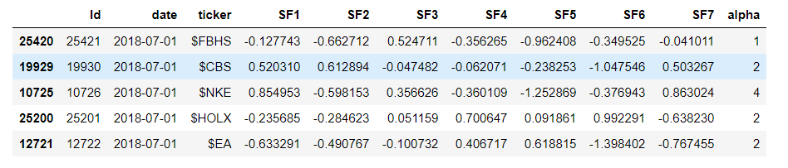
(1)Cleaning_Preprocessing_Feature Engineering of Stock Factors and Tweets

Slide 6
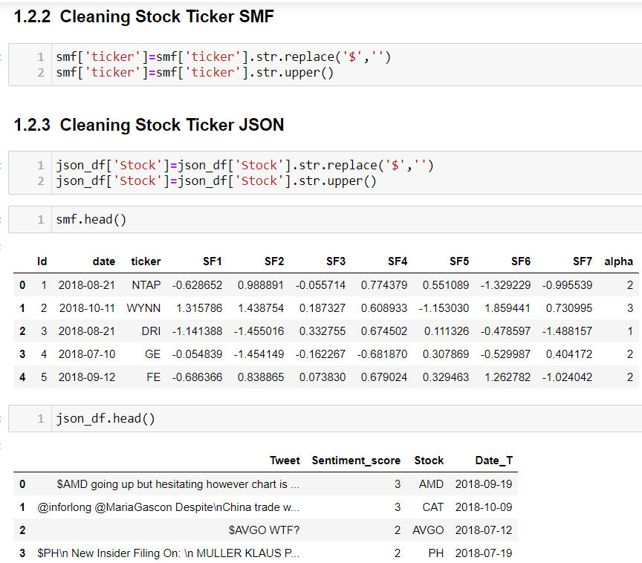
(1)Cleaning_Preprocessing_Feature Engineering of Stock Factors and Tweets

Slide 7
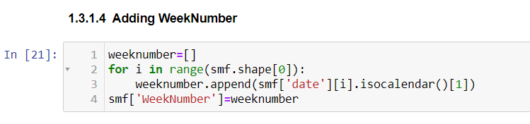
(1)Cleaning_Preprocessing_Feature Engineering of Stock Factors and Tweets

Slide 8
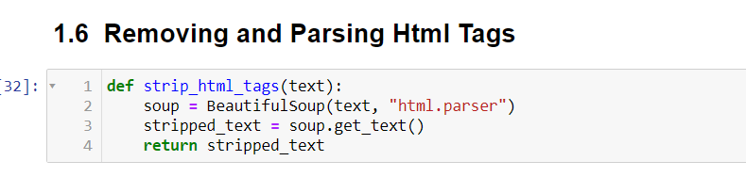
(1)Cleaning_Preprocessing_Feature Engineering of Stock Factors and Tweets

Slide 9
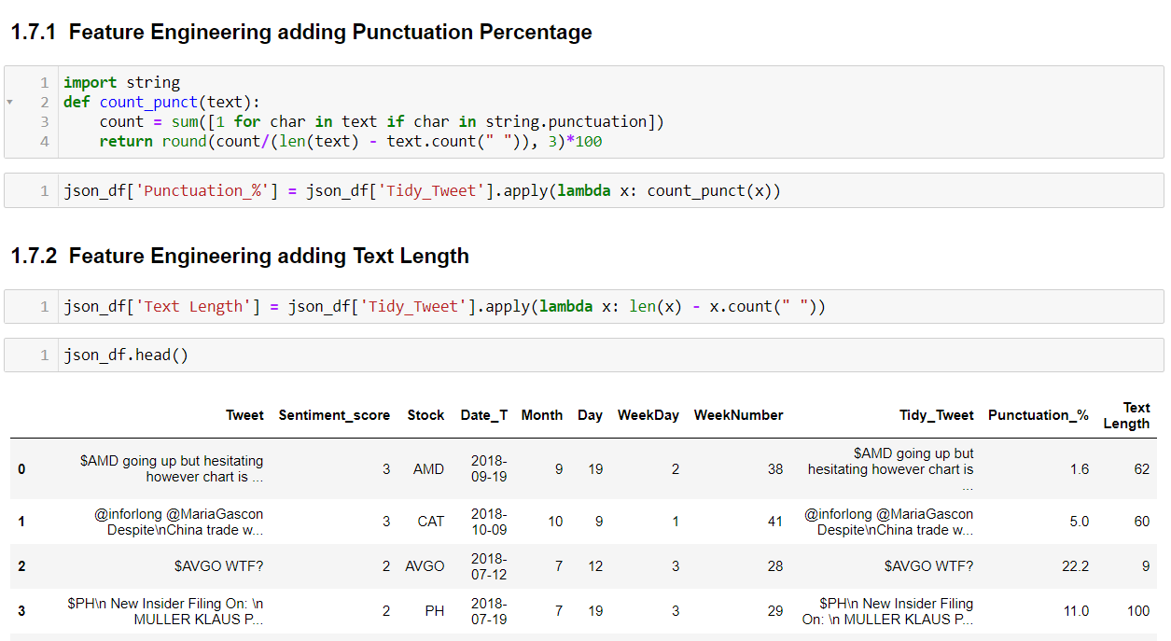
(1)Cleaning_Preprocessing_Feature Engineering of Stock Factors and Tweets

Slide 10
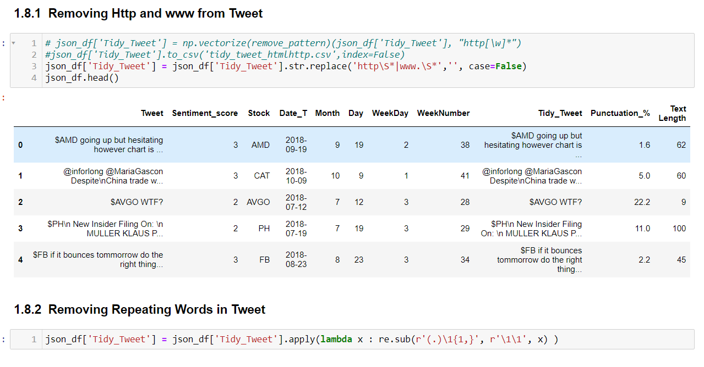
(1)Cleaning_Preprocessing_Feature Engineering of Stock Factors and Tweets

Slide 11
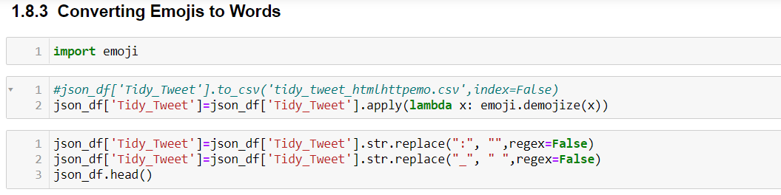
(1)Cleaning_Preprocessing_Feature Engineering of Stock Factors and Tweets

Slide 12
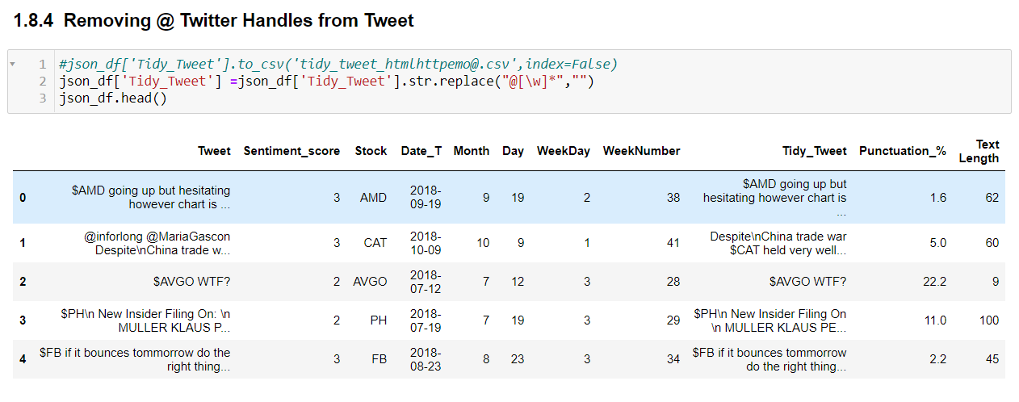
(1)Cleaning_Preprocessing_Feature Engineering of Stock Factors and Tweets

Slide 13
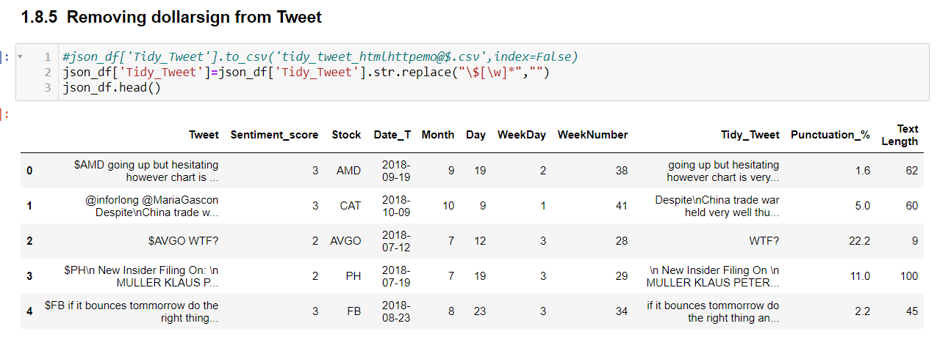
(1)Cleaning_Preprocessing_Feature Engineering of Stock Factors and Tweets

Slide 14
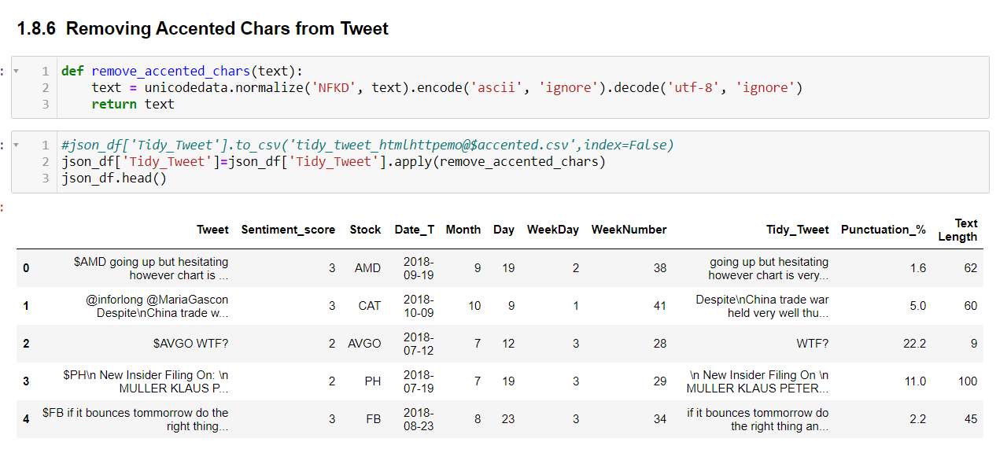
(1)Cleaning_Preprocessing_Feature Engineering of Stock Factors and Tweets

Slide 15
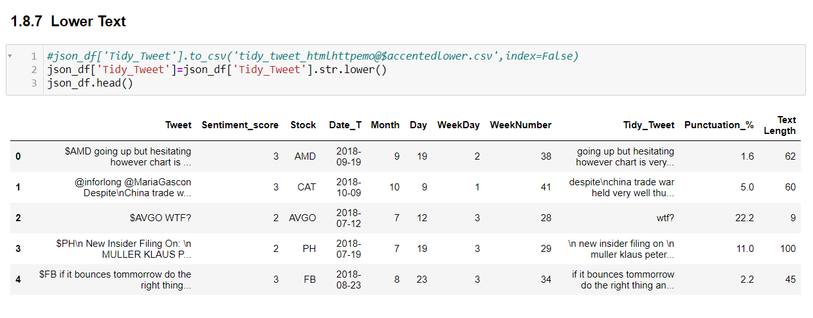
(1)Cleaning_Preprocessing_Feature Engineering of Stock Factors and Tweets

Slide 16
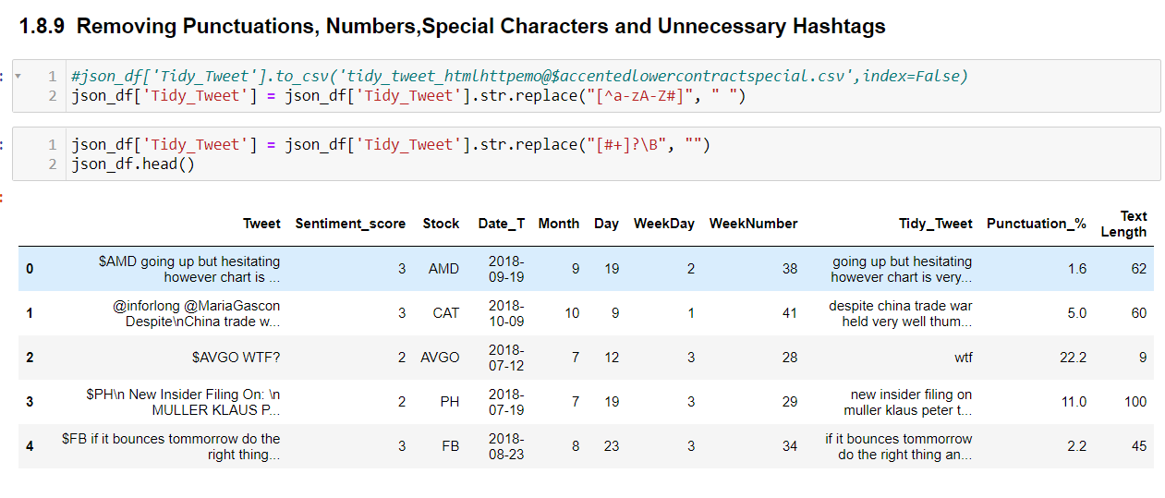
(1)Cleaning_Preprocessing_Feature Engineering of Stock Factors and Tweets

Slide 17
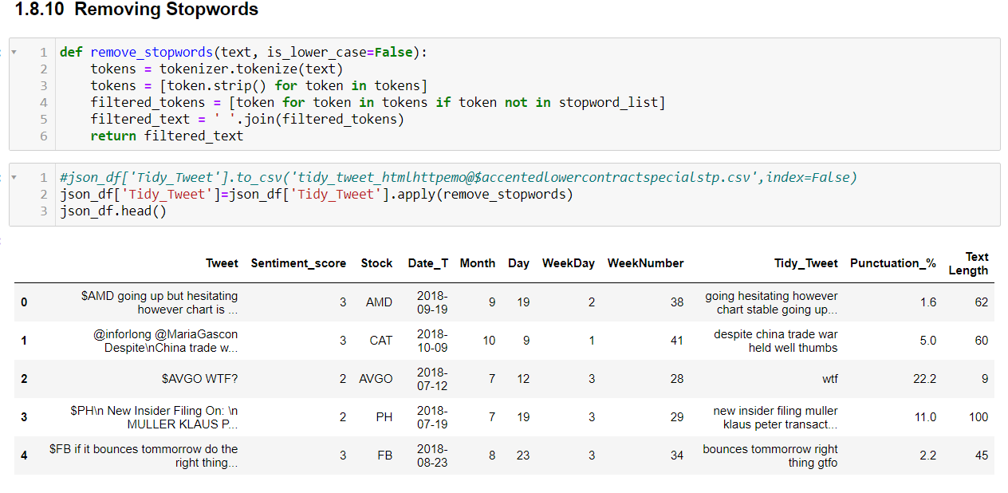
(1)Cleaning_Preprocessing_Feature Engineering of Stock Factors and Tweets

Slide 18
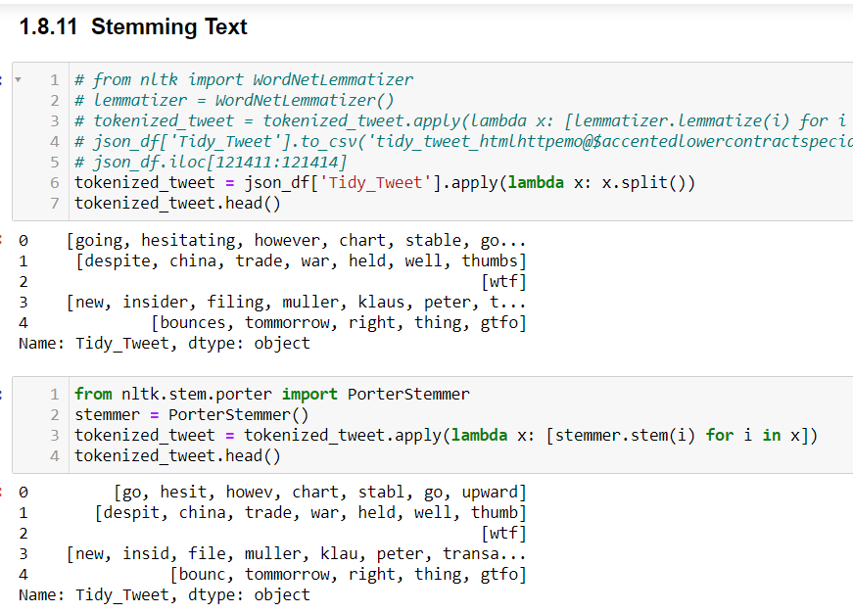
(1)Cleaning_Preprocessing_Feature Engineering of Stock Factors and Tweets

Slide 19
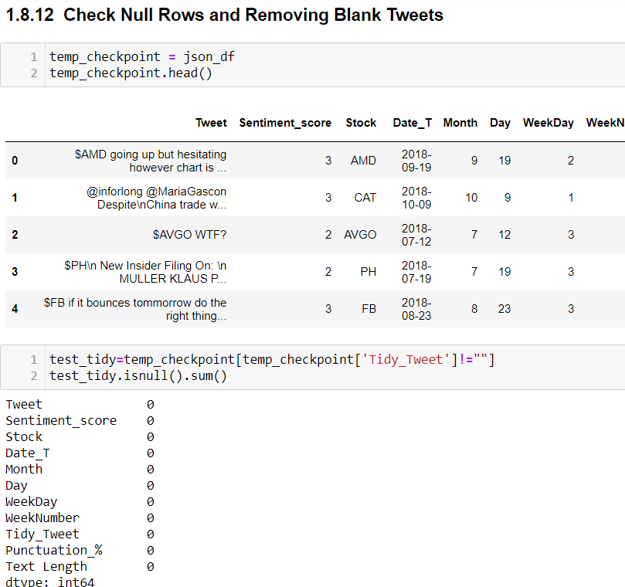
(1)Cleaning_Preprocessing_Feature Engineering of Stock Factors and Tweets

Slide 20
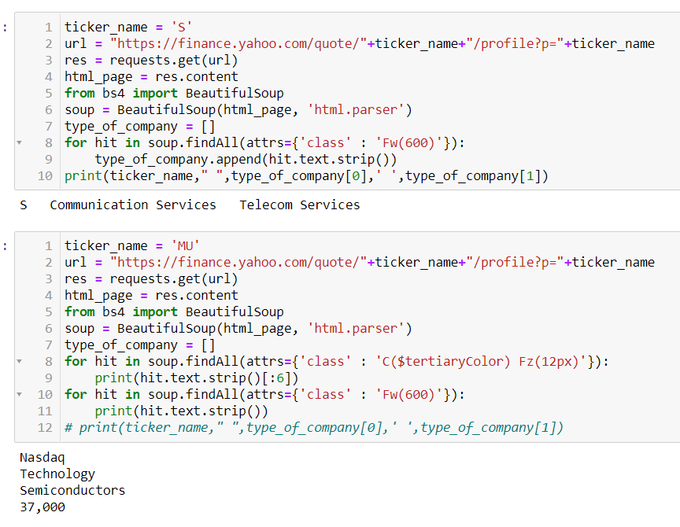
(1)Cleaning_Preprocessing_Feature Engineering of Stock Factors and Tweets (Tried but didn’t Execute)

Slide 21
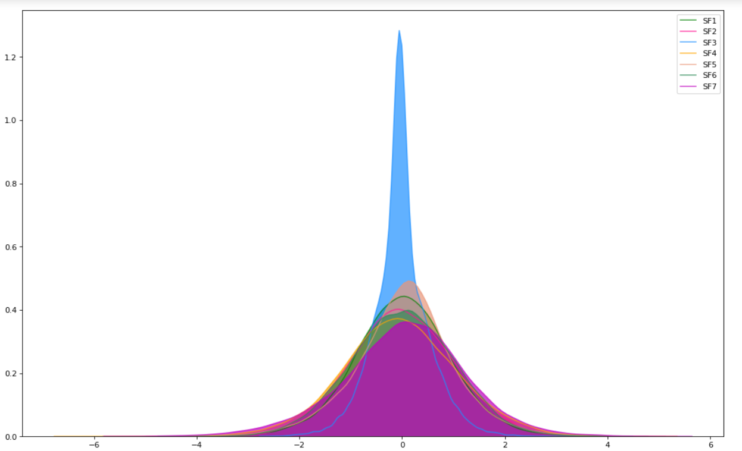
(2)Visualization of Stock Factors and Tweets
Kde plot of Stock Factors

Slide 22
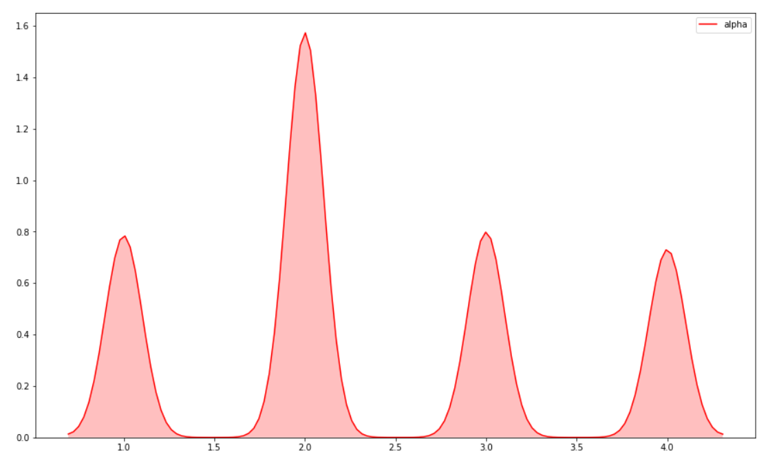
(2)Visualization of Stock Factors and Tweets
Kde plot of Alpha

Slide 23
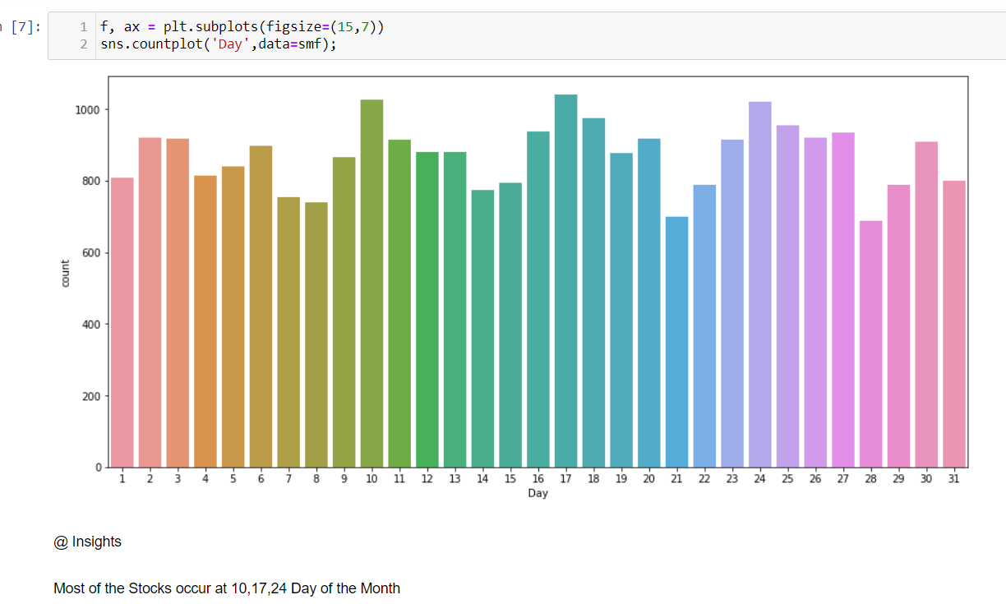
(2)Visualization of Stock Factors and Tweets
Count plot of Stock Factors

Slide 24
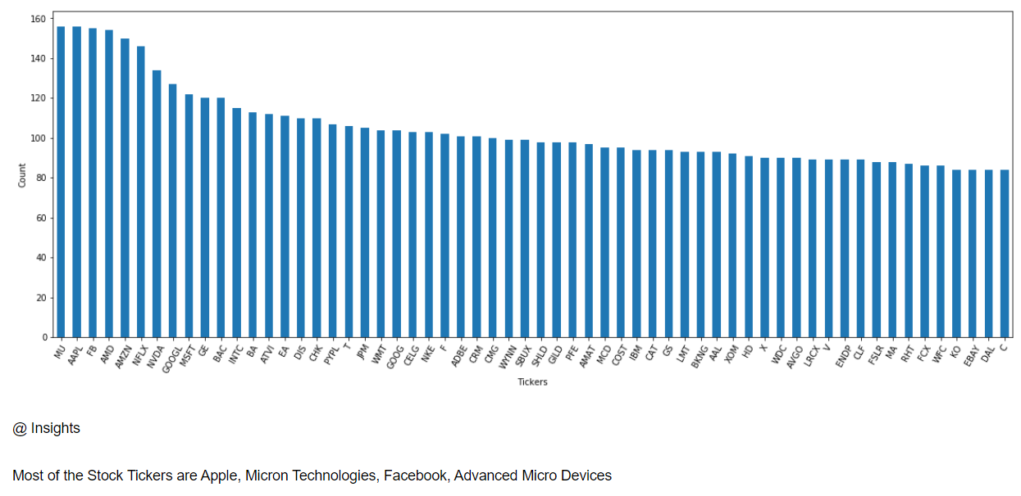
(2)Visualization of Stock Factors and Tweets
Bar plot of Stock Tickers

Slide 25
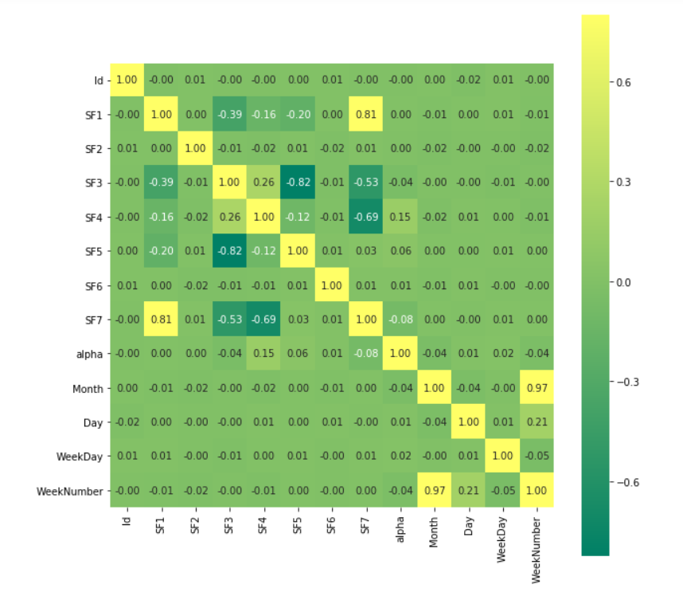
(2)Visualization of Stock Factors and Tweets
Corr plot of Stock Factors

Slide 26
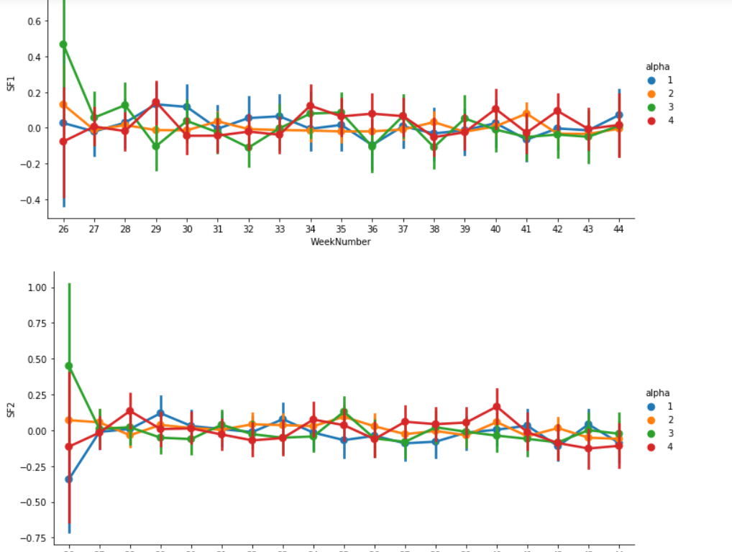
(2)Visualization of Stock Factors and Tweets
Factor plot by WeekNumbers with Alpha Signals

Slide 27
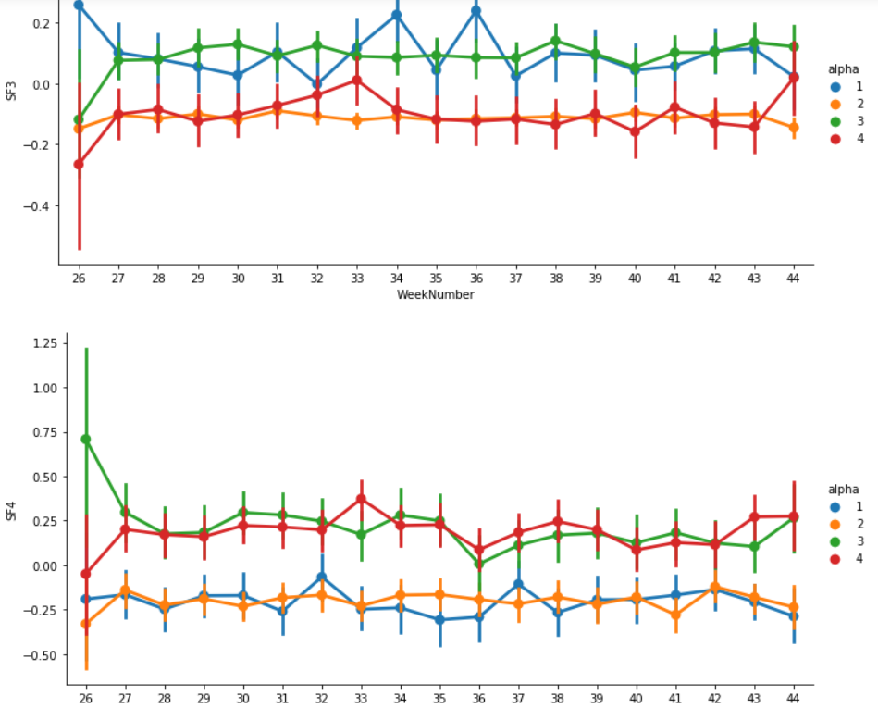
(2)Visualization of Stock Factors and Tweets
Kde plot of Stock Factors

Slide 28
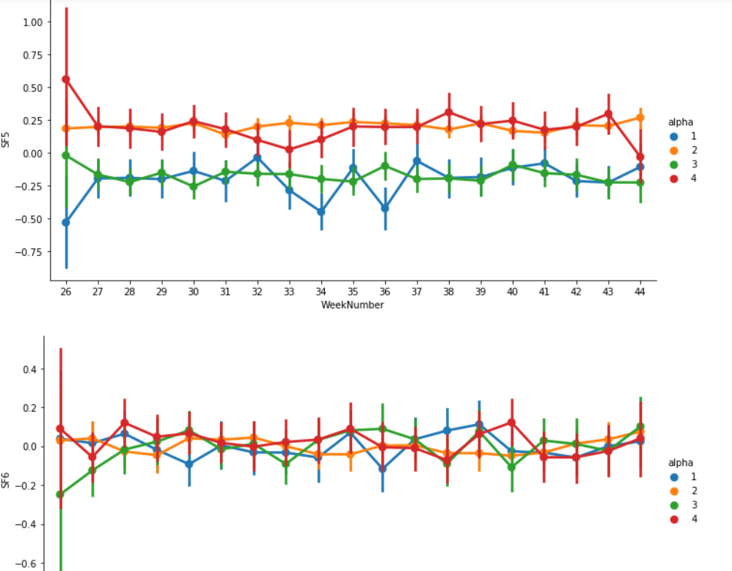
(2)Visualization of Stock Factors and Tweets
Kde plot of Stock Factors

Slide 29
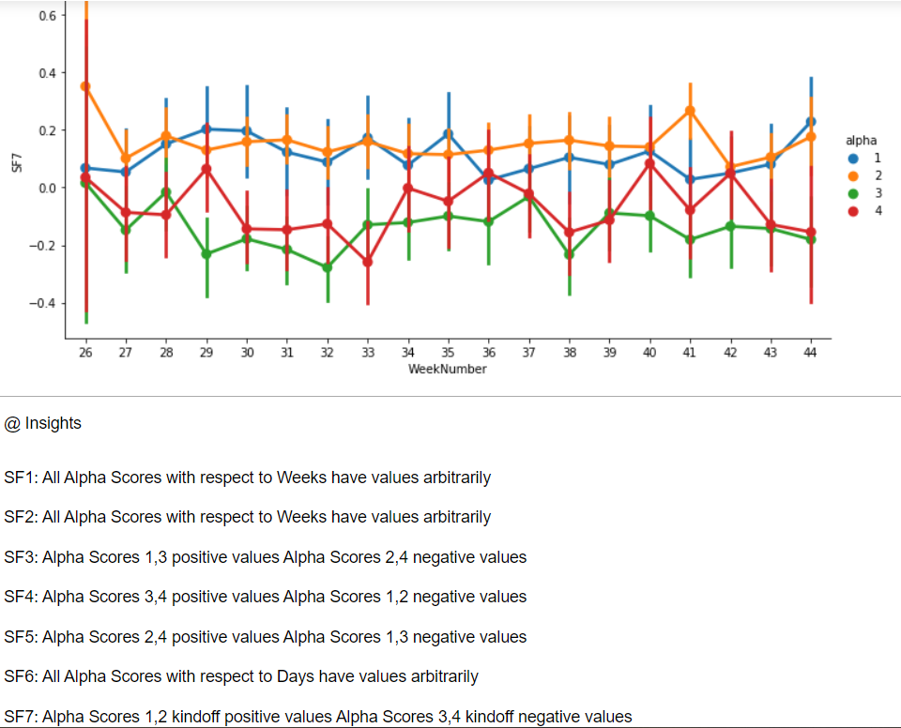
(2)Visualization of Stock Factors and Tweets
Kde plot of Stock Factors

Slide 30
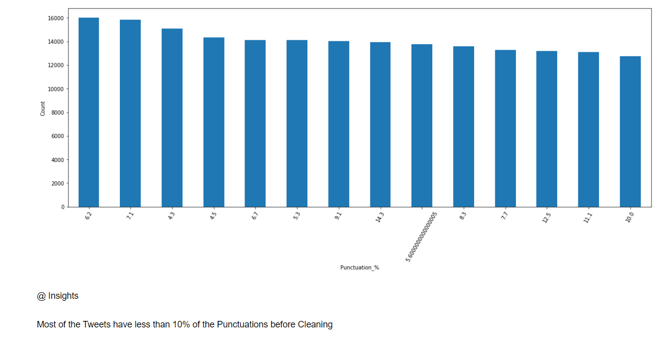
(2)Visualization of Stock Factors and Tweets
Tweet Punctuation % Bar Chart

Slide 31
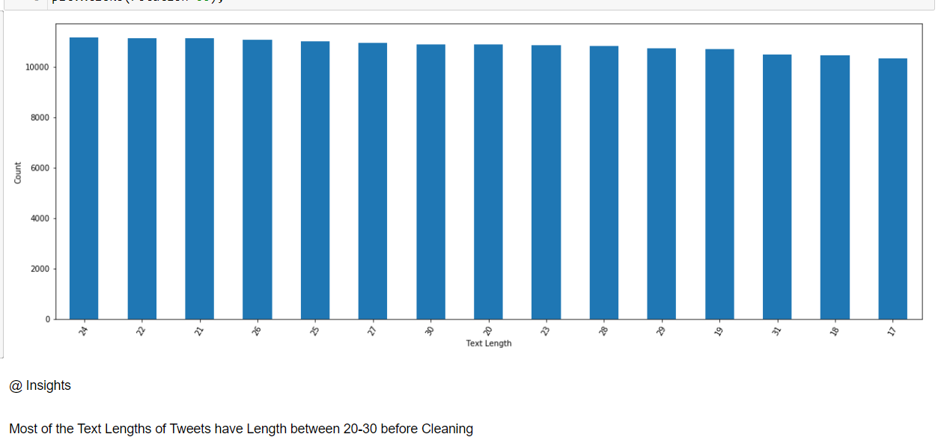
(2)Visualization of Stock Factors and Tweets
Text Length of Tweets before Cleaning

Slide 32
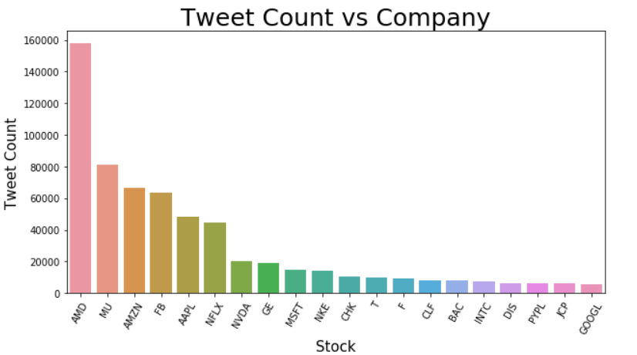
(2)Visualization of Stock Factors and Tweets
Tweet Counts by Stock Ticker(Company)

Slide 33
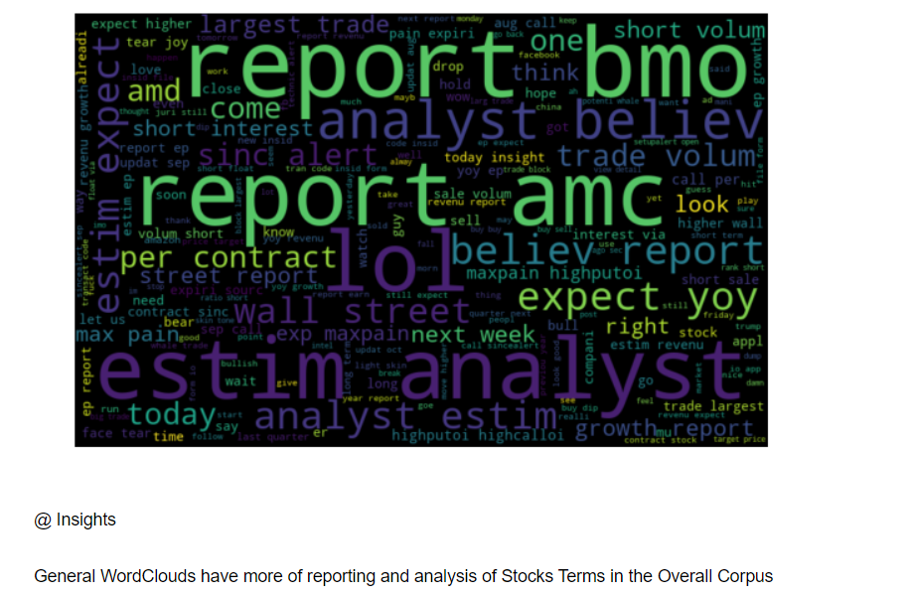
(2)Visualization of Stock Factors and Tweets

Slide 34
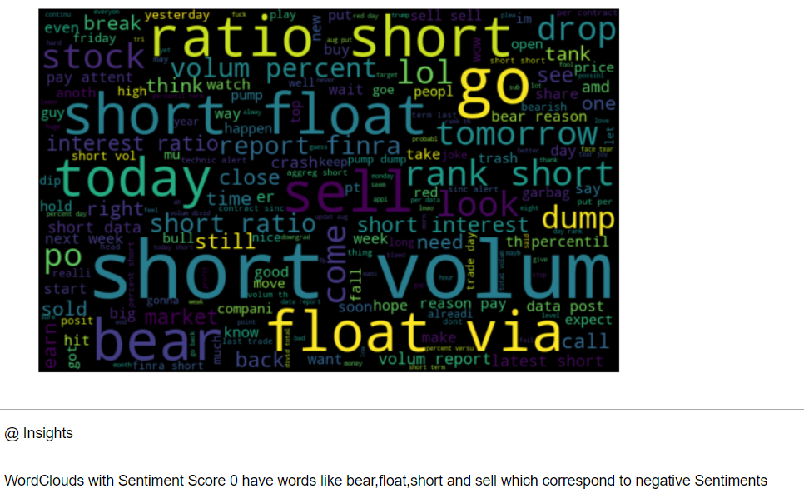
(2)Visualization of Stock Factors and Tweets

Slide 35
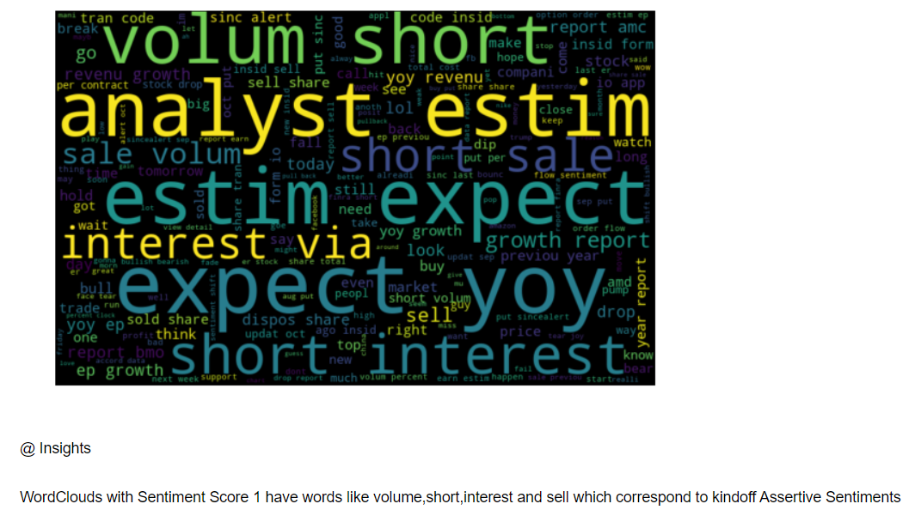
(2)Visualization of Stock Factors and Tweets

Slide 36
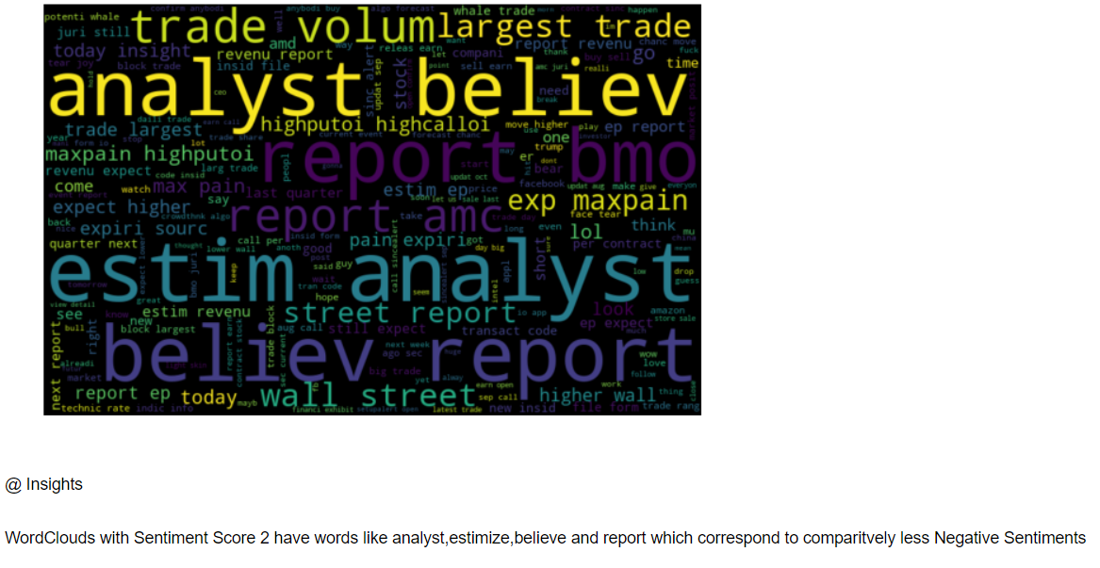
(2)Visualization of Stock Factors and Tweets

Slide 37
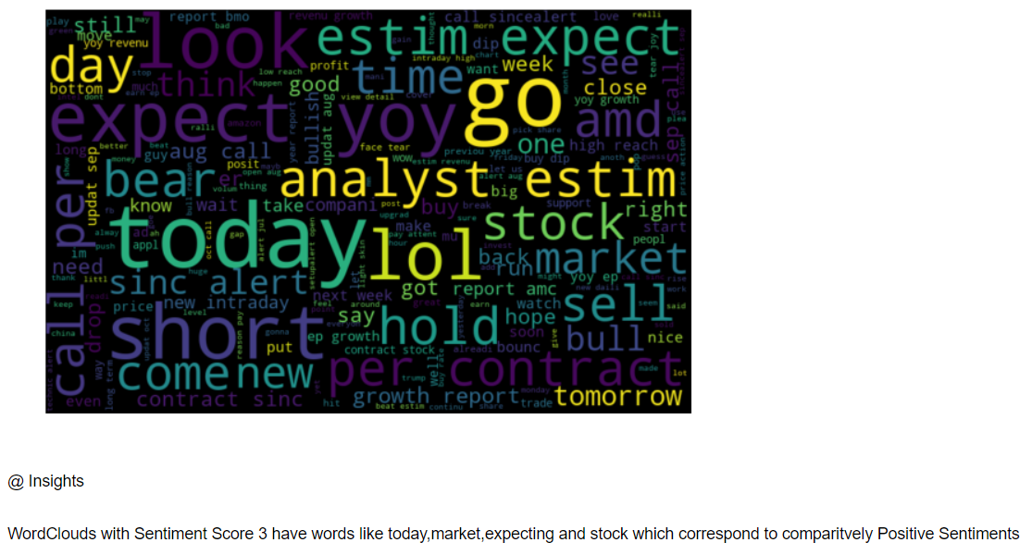
(2)Visualization of Stock Factors and Tweets

Slide 38
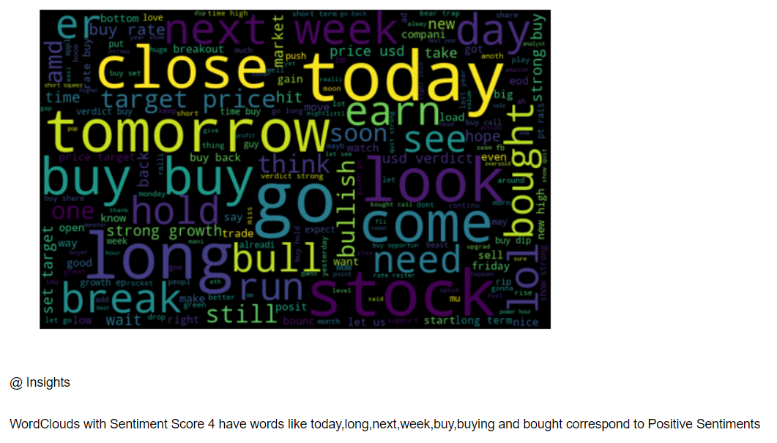
(2)Visualization of Stock Factors and Tweets

Slide 39
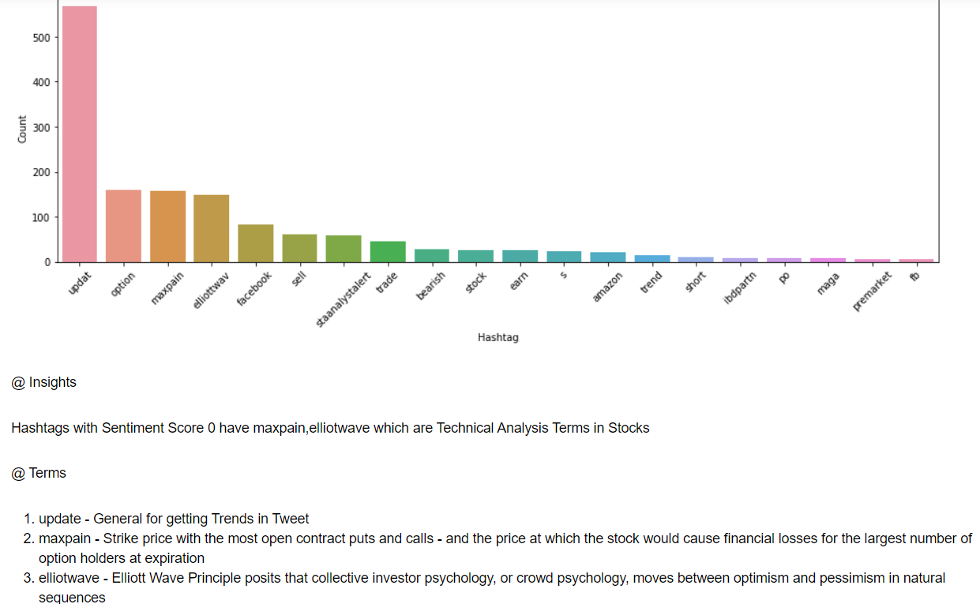
(2)Visualization of Stock Factors and Tweets

Slide 40
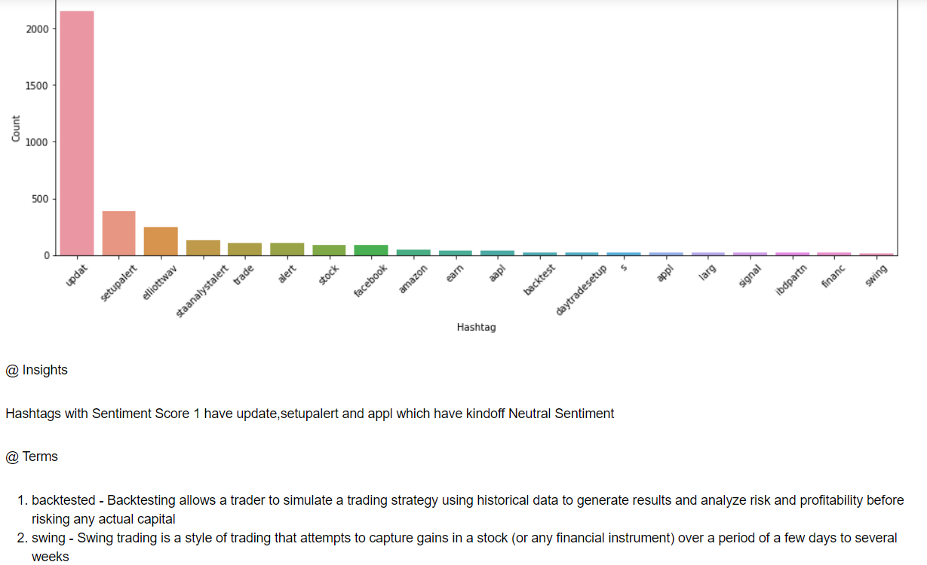
(2)Visualization of Stock Factors and Tweets

Slide 41
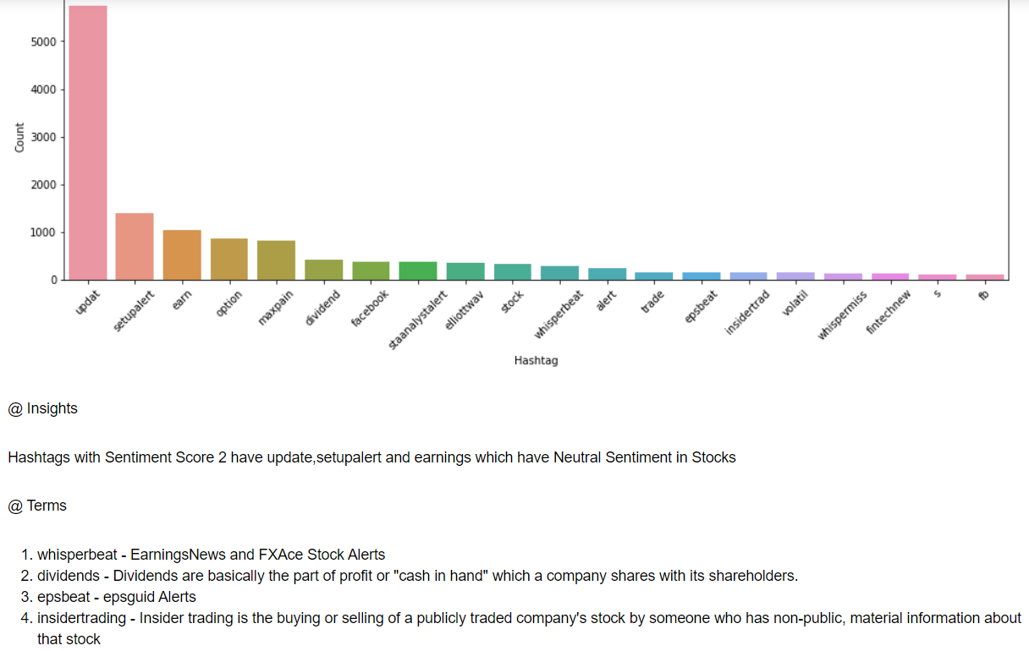
(2)Visualization of Stock Factors and Tweets

Slide 42
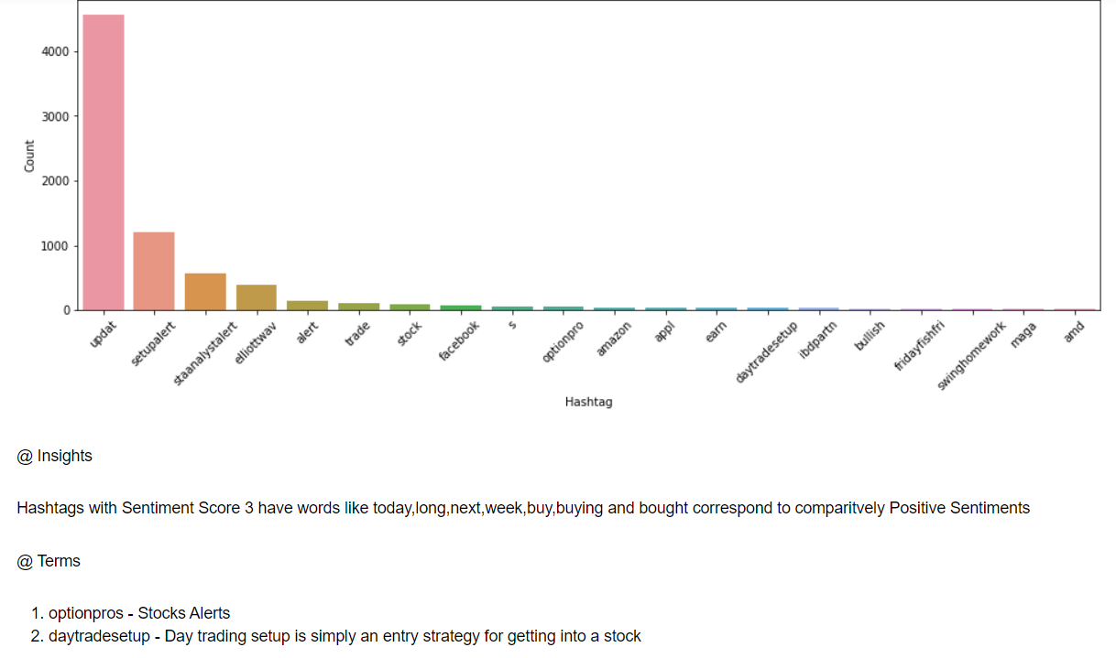
(2)Visualization of Stock Factors and Tweets

Slide 43
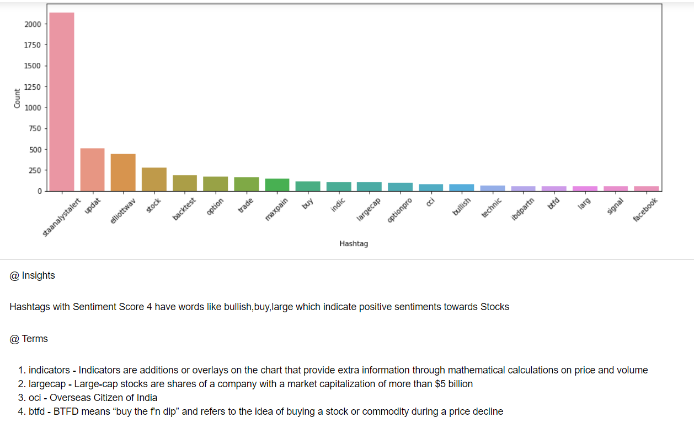
(2)Visualization of Stock Factors and Tweets

Slide 44
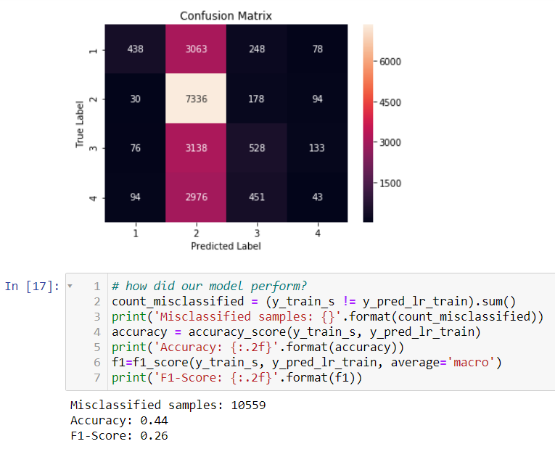
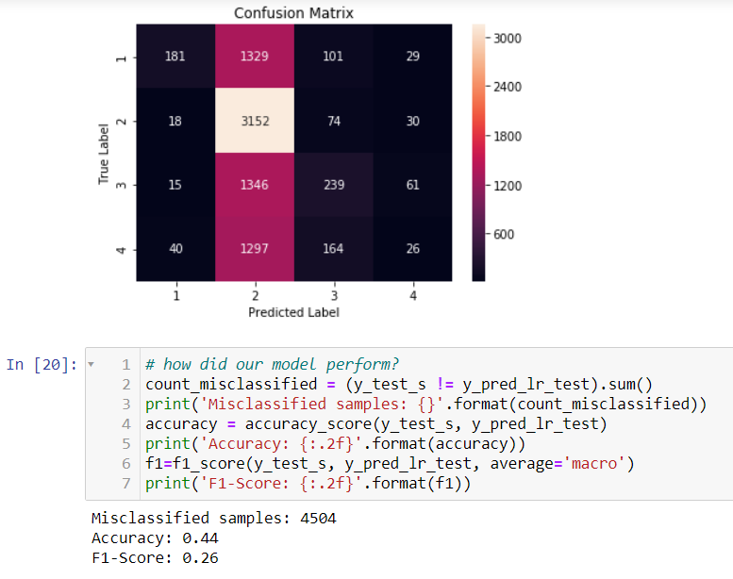
(3)Simple Model of Stock Factors
(1)Logistic Regression

Slide 45
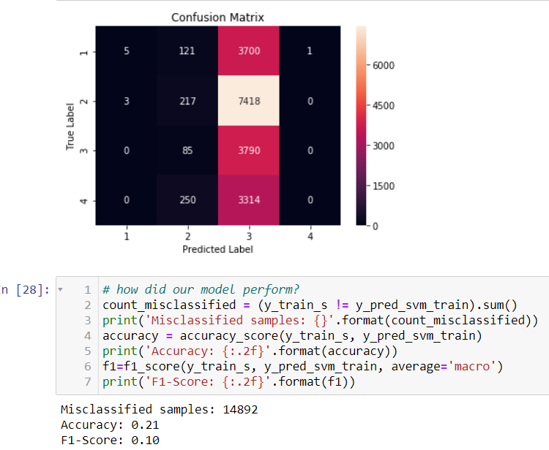
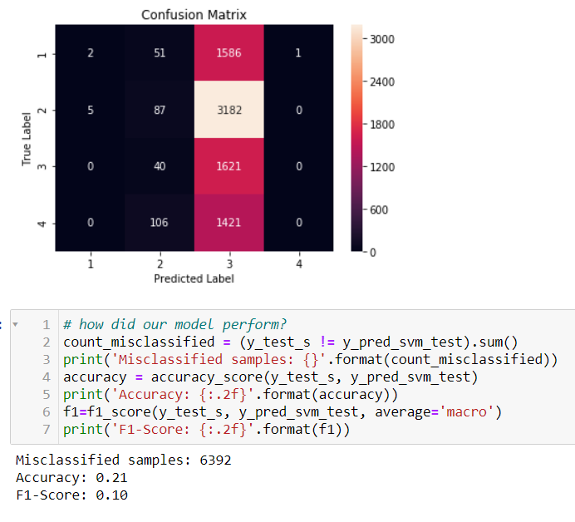
(3)Simple Model of Stock Factors
(2)SVM

Slide 46
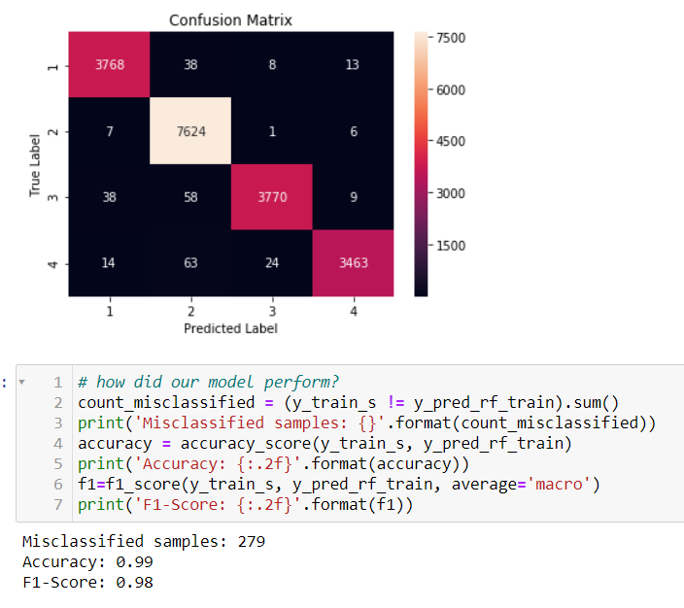
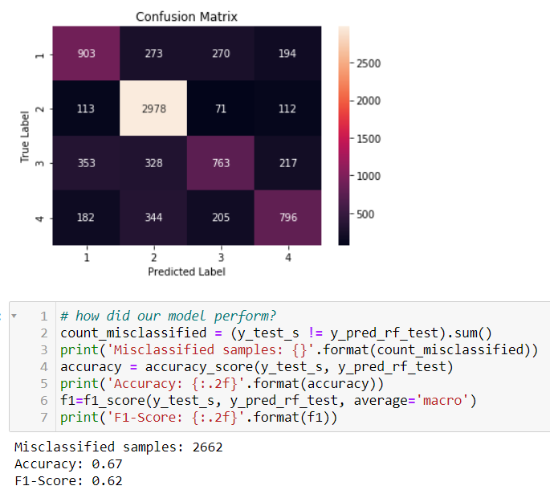
(3)Simple Model of Stock Factors
(3)Random Forest

Slide 47
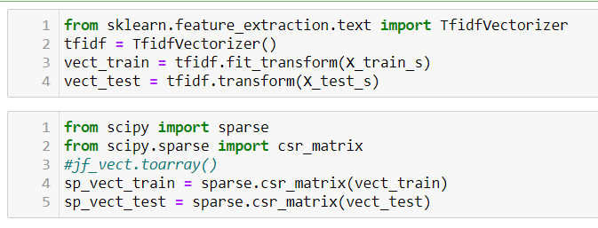
(4)Sentiment Analysis Model
TF-IDF Vectorizer

Slide 48
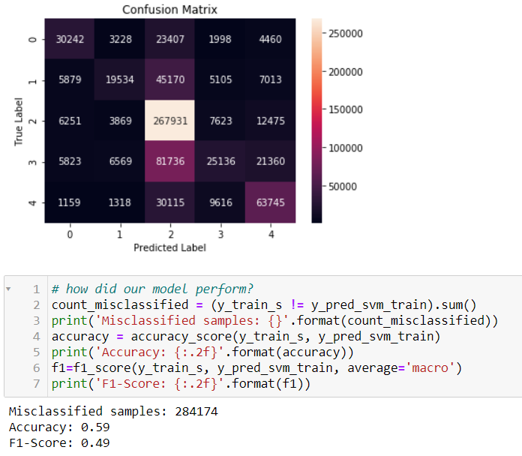

(4)Sentiment Analysis Model
(1)SVM

Slide 49
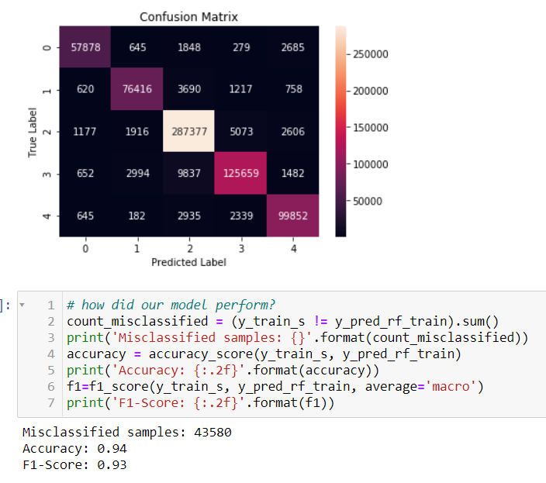
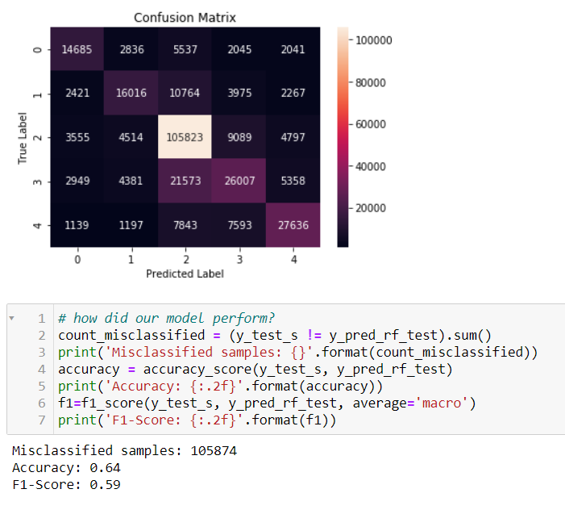
(4)Sentiment Analysis Model
(2)Random Forest

Slide 50
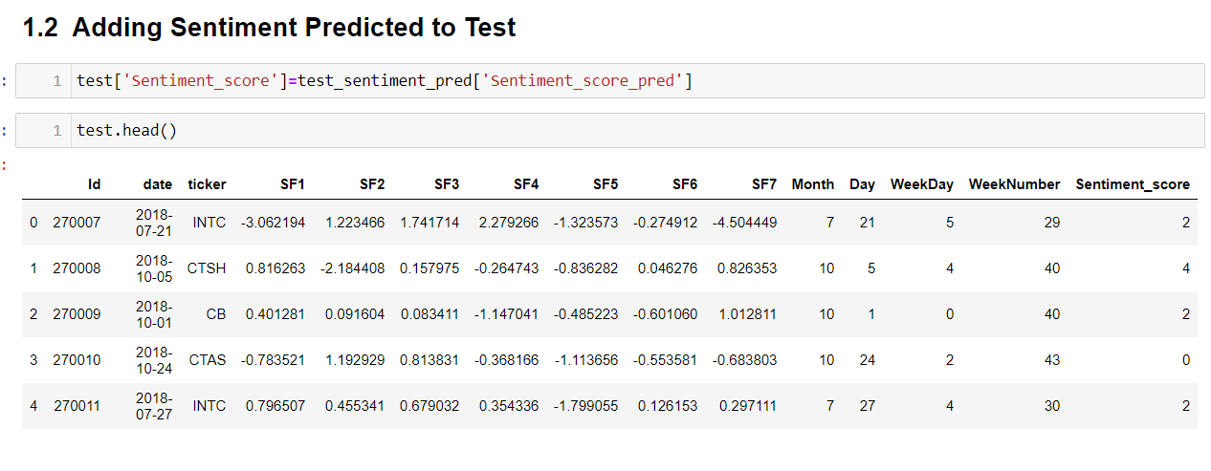
(5)Alpha Sentiment Model

Slide 51

(5)Alpha Sentiment Model

Slide 52

(5)Alpha Sentiment Model

Slide 53


(5)Alpha Sentiment Model
(1)Random Forest

Slide 54

(5)Alpha Sentiment Model
(1)Randomized SearchCV Random Forest

Slide 55


(5)Alpha Sentiment Model
(2)Randomized SearchCV Random Forest

Slide 56

(5)Alpha Sentiment Model
(2)Randomized SearchCV Random Forest Feature Importance

Slide 57

(5)Alpha Sentiment Model
(3)DL

Slide 58
(6)Comparative Study
(1)Simple Stock Factor model gave F1-score of 0.56.The Low Score because of Extra Features added which debased the score.Without would have yielded a score of around 0.65.
2)Adding Sentiment Score does increase the prediction alpha signal by +0.2 to +0.7.
3)Adding Sectors and Industries could have improved or debased the model.

Slide 59
Fin

